Slide 1



Engineering Electromagnetics 工程电磁场
Youwei Jia 嘉有为

Slide 2

11: The Steady Magnetic Field
Force on a Moving Charge
The forces exerted on a point charge by electric and magnetic fields are:
charge can be stationary
or moving
charge is moving
at velocity v
Q
F_{e}
F_{m}
X
+
v
Q
+
E
B
F_{e} = QE
F_{m} = Q (v x B)
in the direction of E
into the screen
1

Slide 3
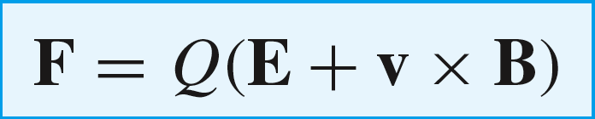
11: The Steady Magnetic Field
Lorentz Force Law
Generally, with both electric and magnetic fields present, we have both forces:
B
The electric field will, in this
case, accelerate the charge in
the direction of E, making it
cross the B field lines in the
perpendicular sense; this gives a
magnetic force component that
is out of the screen
E
Q
+
v
The total force on the moving charge is then the sum of the two, or
This is the Lorentz Force Law (sometimes called the “fifth Maxwell equation”)
2

Slide 4
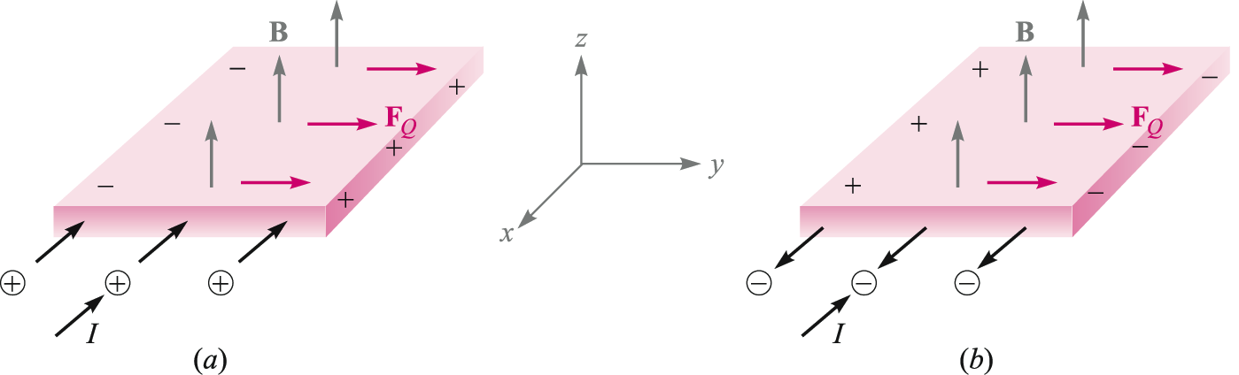
11: The Steady Magnetic Field
Hall Effect
When a B field is applied in a direction perpendicular to a current, positive and negative carriers will be displaced slightly, as shown, as a result of the magnetic forces on the moving charges.
This produces a measurable voltage, known as the Hall Voltage.
3

Slide 5
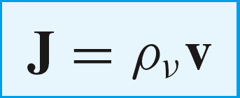


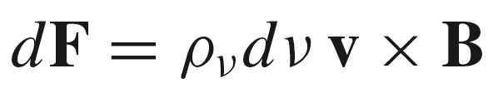
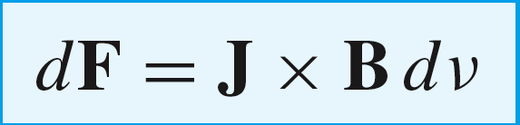
11: The Steady Magnetic Field
Force on a Differential Current Element
dv
Consider a small segment (length dL)
of current in the form of a volume
current density J, suspended in a magnetic
field, B. The current element has volume dv.
dL
J
B
We know that current density is volume charge density moving at velocity v:
..and we can write the differential force on a differential charge, dQ:
where
Therefore:
..so that finally:
4

Slide 6
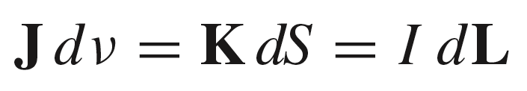
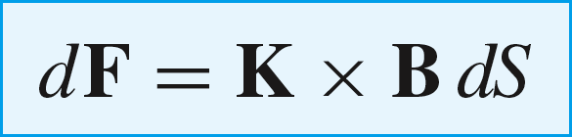

11: The Steady Magnetic Field
Other Expressions for Differential Force
For volume current, surface current, or filament current, we have the appropriate expressions for differential current:
The corresponding expressions for differential force within magnetic field B are:
volume current density (three dimensions)
surface current density (two dimensions)
filament current of length dL (one dimension)
5

Slide 7
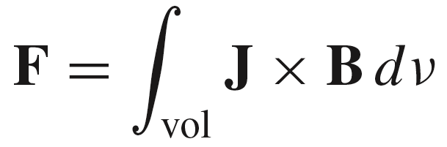
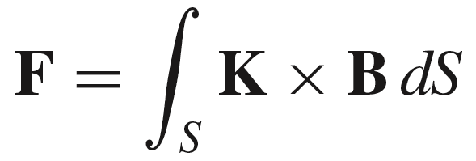
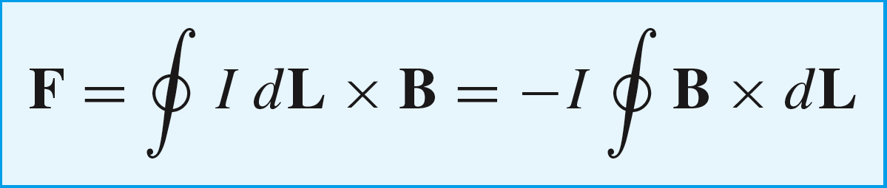
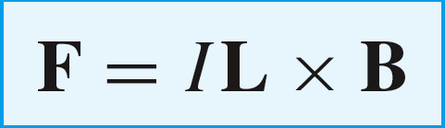

11: The Steady Magnetic Field
Evaluating the Total Force
In three or two dimensions,
the net force is found by
integrating over the volume
or surface that the current occupies
For a filament current, the total force will be the integral of the differential force, generally taken over the closed path that comprises the current:
For a straight filament of length L, having uniform current, and within a uniform field, this becomes:
which in turn reduces to
6

Slide 8
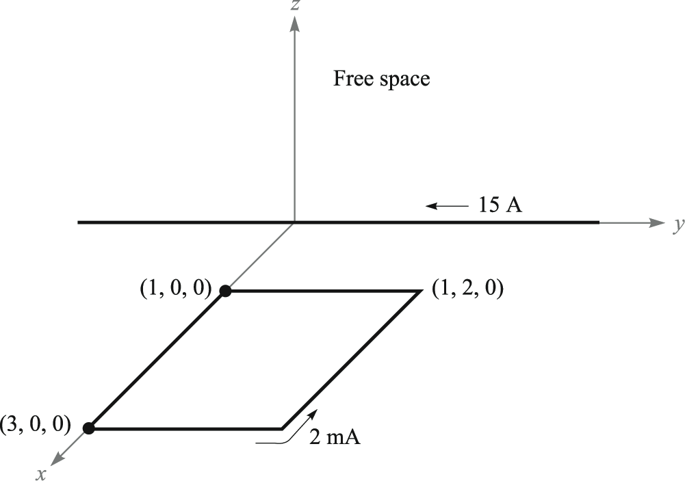
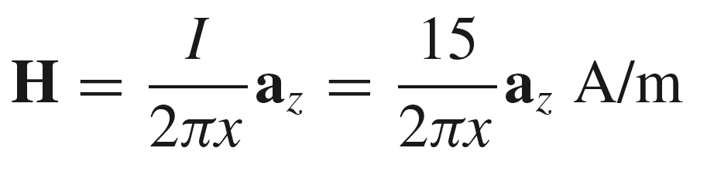
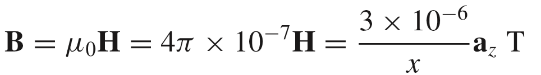
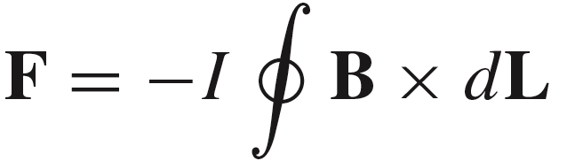
11: The Steady Magnetic Field
Example: Force on a Square Current Loop
The magnetic field arising from the straight wire,
evaluated in the plane of the loop, is:
The B field is then:
The total force on the loop is then found by evaluating:
over all four loop segments
7

Slide 9
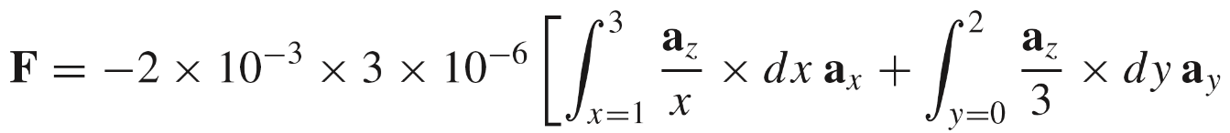
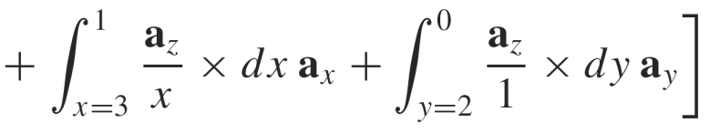
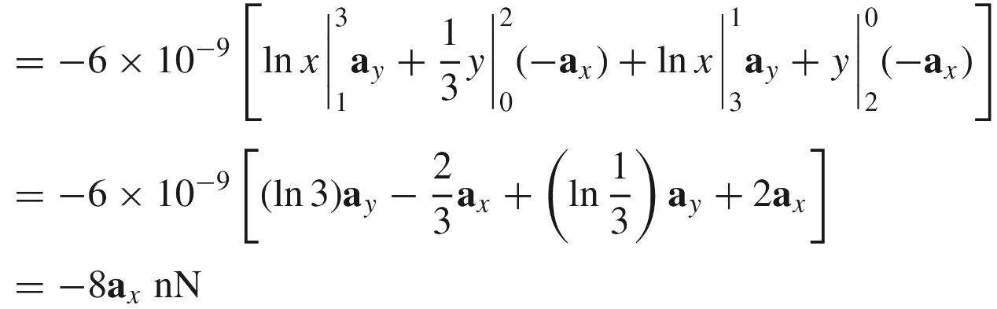
11: The Steady Magnetic Field
Example: Force on a Square Current Loop
The integral becomes:
A
B
D
A
C
C
D
B
8

Slide 10
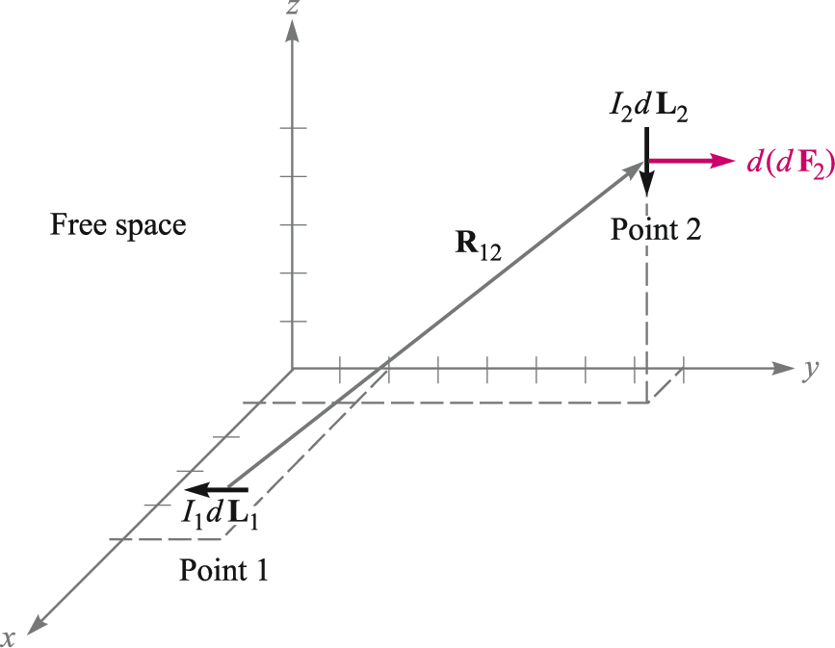
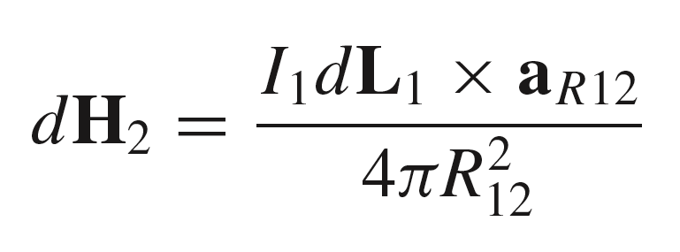
11: The Steady Magnetic Field
Force Between Differential Current Elements
We use the Biot-Savart Law to find the differential magnetic field at Point 2 that arises from the differential current element at Point 1:
dH₂
a_{R12}
The flux density associated with this field
will generate a force on an additional current
element at Point 2
9

Slide 11
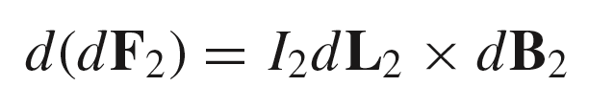

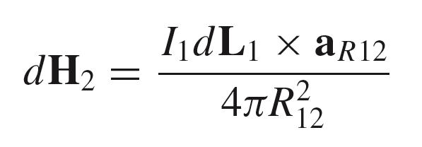

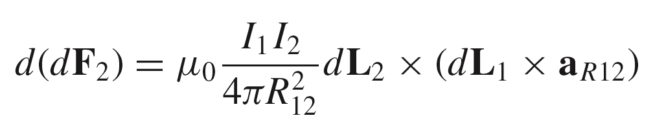
11: The Steady Magnetic Field
Force Between Differential Current Elements
A second differential current element is now placed
at Point 2. It will experience a force given by:
Then with:
a_{R12}
where:
we finally obtain:
10

Slide 12




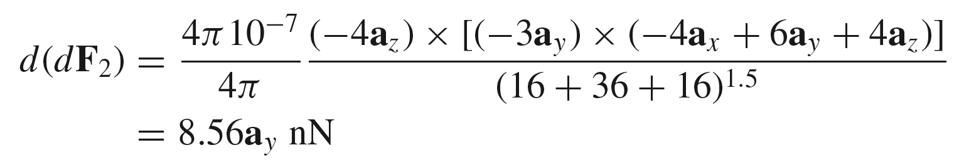
11: The Steady Magnetic Field
Example
Given:
Then
a_{R12}
Substitute these into:
Obtain:
11

Slide 13
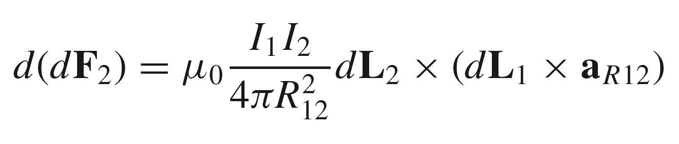
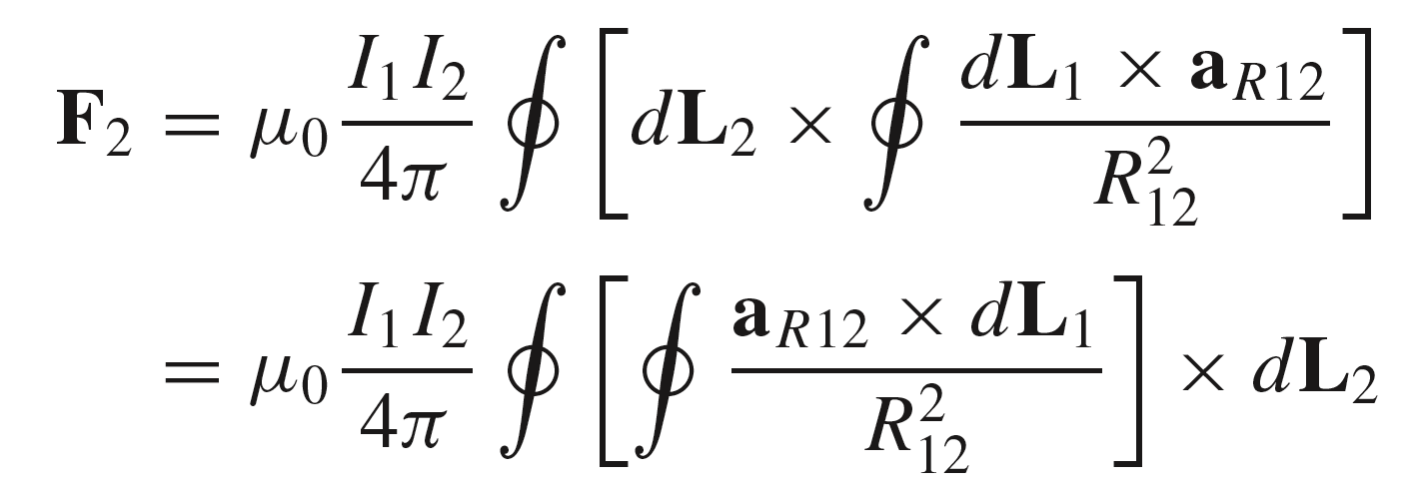
11: The Steady Magnetic Field
Force Between Current Filaments of Finite or Infinite Lengths
The force is found by integrating the differential filament result:
in which the integral is taken over the lengths of both filaments. To be complete, both integrals would be taken over the closed loops that the currents must form, thus the general expression:
These integrals can
be modified to incorporate
specific limits, in order to
find the force from a
specified segment of a
wire that acts on a specific
segment of another wire
12

Slide 14



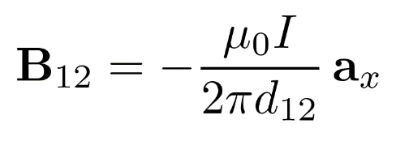


11: The Steady Magnetic Field
Example: Force Between Parallel Wires (the easy way)
Consider the two wires shown here, carrying equal and opposite currents, I, and spaced by distance d₁₂ along the y axis. The wires are oriented in the z direction
and both are infinitely long.
z
The force is to be found on a length of wire 2,
of equal extent above and below the y axis.
I
We can solve this one fairly quickly by observing
that the B field from wire 1 at the location of wire 2
will be:
x
B₁₂
d₁₂
y
and
I
wire 1
wire 2
13

Slide 15
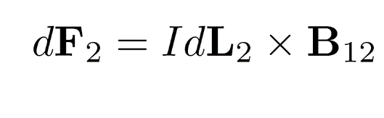
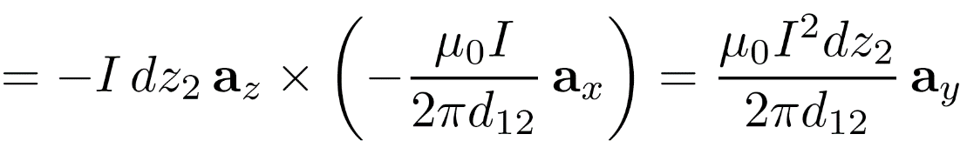
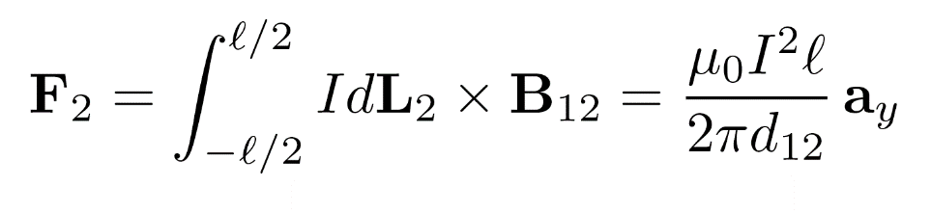
11: The Steady Magnetic Field
Example: Force Between Parallel Wires (the easy way)
We have:
and
Then the force acting on the differential element shown is:
z
I
x
B₁₂
The total force on the length is therefore:
d₁₂
y
….which is a repulsive force
I
wire 1
wire 2
14

Slide 16
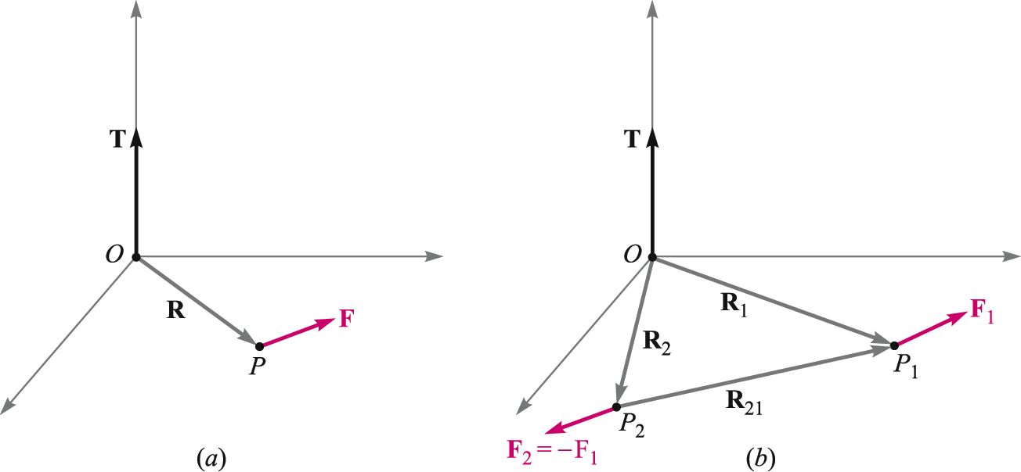
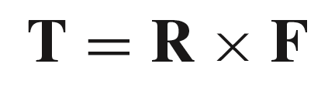
11: The Steady Magnetic Field
Torque 转矩: Basic Definition
Given a force F at point P, the torque
about the origin is a vector that is perpendicular
to the plane containing F and position vector
R. The torque vector is the cross product:
15

Slide 17
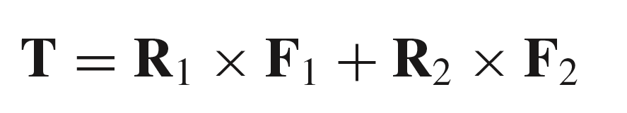
11: The Steady Magnetic Field
Torque: General Equation
Now, consider two equal and opposite
forces, applied at points P₁ and P₂ as shown.
As the net force is zero, there is no translation of the object.
The net torque on the system will be:
But since F₂ = -F₁ :
This means that the torque is independent of the choice of origin, provided the total
force acting is zero. This applies to any number of forces. And the origin can be
located anywhere that is convenient.
16

Slide 18
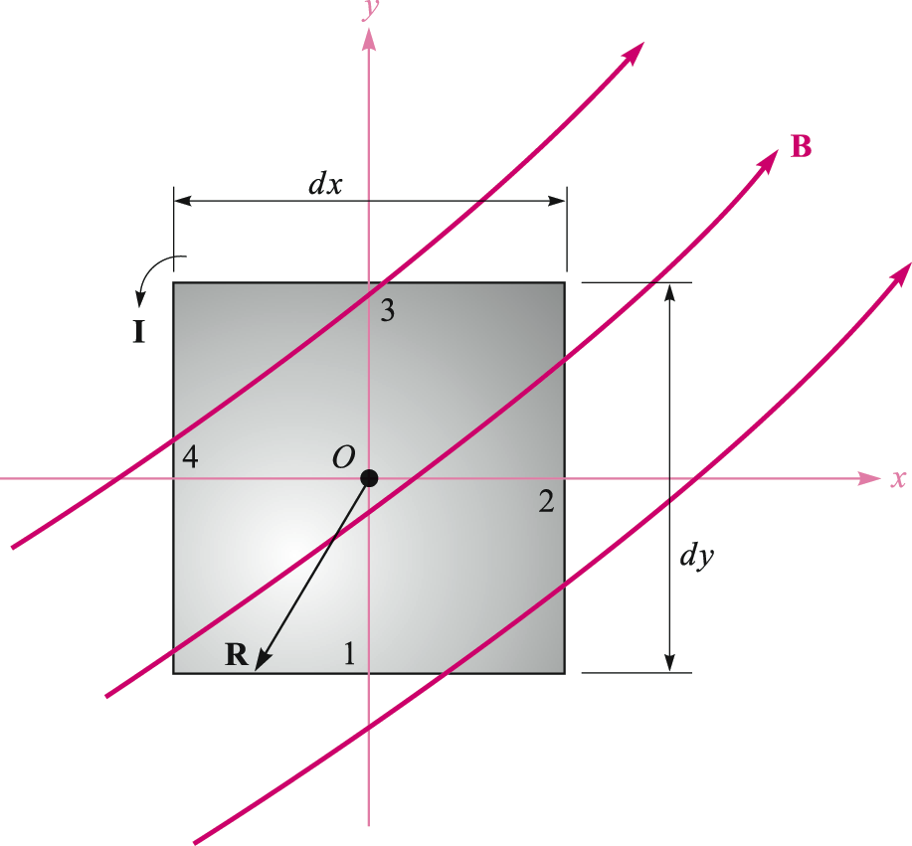

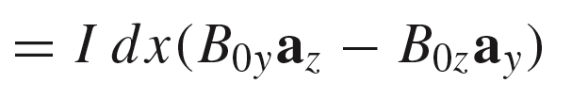
11: The Steady Magnetic Field
Torque on a Differential Current Loop
The filament loop shown here lies in the xy plane with
its center at the origin. Magnetic flux density B
exists everywhere, and in a general direction. As the
loop is of differential size, the magnitude of B is
assumed uniform over the loop area, and has value B₀.
Current I circulates around the loop.
The differential force acting on side 1 is:
17

Slide 19
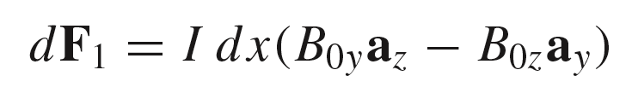
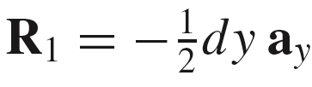
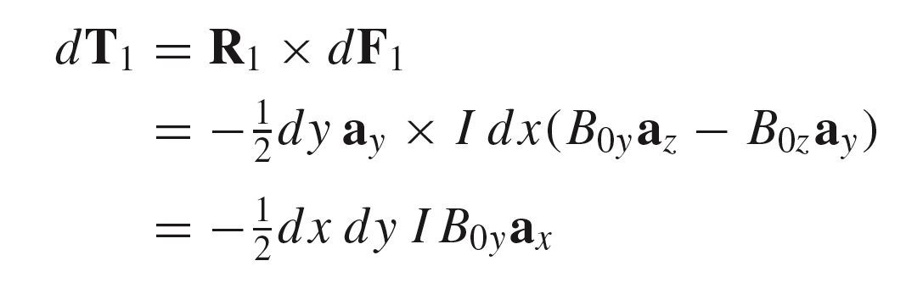
11: The Steady Magnetic Field
Torque on a Differential Current Loop
We have the differential force acting on side 1:
For side 1, the lever arm extends from
the origin to the midpoint of the side, and
is given by:
R₁
The differential torque acting on side 1 is then:
18

Slide 20

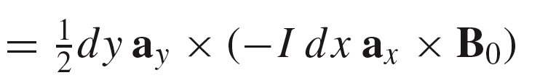
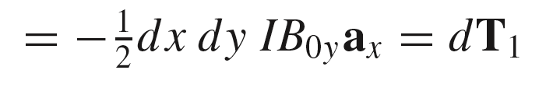


11: The Steady Magnetic Field
Torque on a Differential Current Loop
We next consider the opposite side (3), and
using similar reasoning, find the differential
torque acting on side 3:
R₃
The total differential torque acting on sides 1 and 3 is then:
Then, using the same reasoning, the total differential
torque acting on sides 2 and 4 is:
19

Slide 21
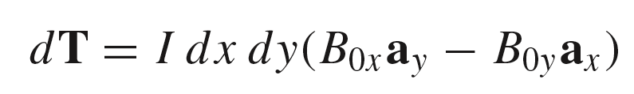
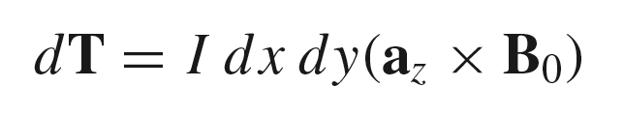
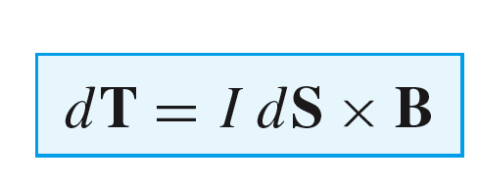
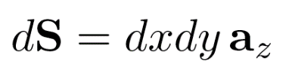
11: The Steady Magnetic Field
Torque on a Differential Current Loop
Now, with:
and
The total torque on all four sides is:
The terms in parenthesis can be written as a cross product:
Finally resulting in:
dS points out of the screen in this example
where the differential loop area vector is defined using the right hand convention:
Fingers in direction of current, thumb in direction of S
20

Slide 22
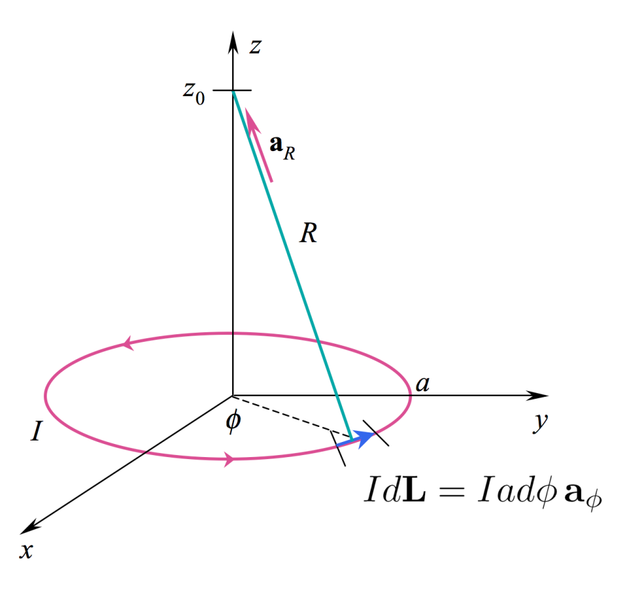
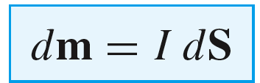
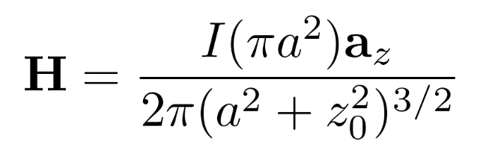

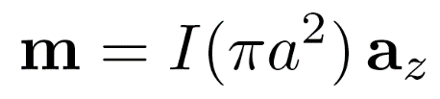
11: The Steady Magnetic Field
Differential Magnetic Moment
Having found the torque on a differential current loop:
Magnetic Dipole
磁偶极子
Define the differential magnetic dipole moment as the product of the current and
the differential area vector:
from which:
21

Slide 23
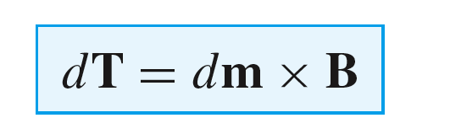
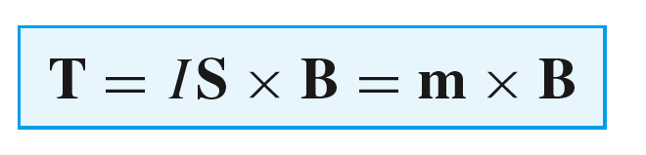
11: The Steady Magnetic Field
Torque on a Large-Scale Current Loop
If we remove the restriction on differential size, and assume uniform magnetic flux density over the entire loop area, the differential result
becomes:
These results are independent of the shape of the loop -- the area and orientation
are all that matter.
22

Slide 24



11: The Steady Magnetic Field
Example
23

Slide 25

11: The Steady Magnetic Field
Magnetic Materials
Materials are characterized according to their configurations of -- and interactions between -- atomic magnetic moments. On the atomic or molecular scale, magnetic moments are associated with electron orbital configurations, electron spin自旋, and
(to a lesser extent) nuclear spin.
m_{orb}
The diagram shows contributions to the total magnetic moment of an atom that arise from the electron orbit (m_{orb}) and electron spin (m_{spin}), in which the latter vector may add to or subtract from the
orbital moment.
The magnetic flux density, B₀, is
externally applied.
m_{spin} (positive or negative)
24

Slide 26
11: The Steady Magnetic Field
Magnetic Materials: Diamagnetisim 抗/反磁性
m_{orb}
In this case, the summation of all orbital and spin magnetic
moments associated with all electrons in a single atom is
precisely zero, with the atom in its unperturbed state.
Application of a magnetic field leads
to an outward radial force F_{m} on the orbiting
electron shown here, resulting in a decrease
in its orbital velocity in order to maintain a
balance of Coulomb and magnetic forces.
A rough sketch of what is going on in an atom
(greatly oversimplified!)
The velocity reduction will result
in a lessening of the orbital magnetic
moment, thus producing a very small net
magnetic moment in the direction of the
spin moment; i.e., in the opposite direction
to the applied field.
m_{spin}
(acting to partially cancel the orbital contribution)
F_{m}
Examples of diamagnetic materials: metallic bismuth铋, copper, gold,
silicon, germanium锗, graphite石墨, sulfur硫.
So a net decrease in the magnetic
flux density will occur.
25

Slide 27
11: The Steady Magnetic Field
Magnetic Materials: Paramagnetism 顺磁性
In this case, the summation of all orbital and spin magnetic moments associated with individual atoms is not zero, but is very small. Because of random orientations of adjacent atoms, however, the average magnetic moment in the material is zero.
m_{orb}
Application of a magnetic field on the non-zero moments introduces a torque on the ensemble which results in the partial alignment of the moments of adjacent atoms. This strengthens the overall magnetic flux density.
However, the diamagnetic effect, in addition to the tendency toward random orientations due to molecular activity (increasing with temperature) reduces the net increase in B.
m_{spin}
(adding to the orbital contribution, or not completely cancelling it if negative)
So a net increase in the B field will be seen, but this increase is very small.
F_{m}
Examples of paramagnetic materials: potassium钾, tungsten钨, rare earth elements稀土
26

Slide 28
11: The Steady Magnetic Field
Magnetic Materials: Ferromagnetism 铁磁性
In ferromagnetic materials, fairly
strong atomic or molecular magnetic
moments exist. Moments of adjacent
molecules interact to cause partial alignment of moments within small regions known as domains磁畴. Magnetic moment orientations from domain to domain are random, thus resulting in a zero overall magnetic moment for the material.
27

Slide 29
11: The Steady Magnetic Field
Magnetic Materials: Ferromagnetism 铁磁性
B₀
Application of a steady magnetic field produces greater torque on magnetic moments that are closer to alignment with B₀. Average alignment throughout the material thus increases, but does so through the enlargement of the nearly-aligned domains, at the expense of those that are not aligned with B₀.
A significant increase in the overall magnetic flux density occurs.
Ferromagnetic elements: iron, nickel镍, cobalt钴 (room temperature), gadolinium轧, dysprosium镝 (low temperature).
Another manifestation is found in superparamagnetic超顺磁性materials, consisting of ferromagnetic particles suspended in a non-ferromagnetic matrix (magnetic recording tape is the most common example)
28

Slide 30
11: The Steady Magnetic Field
Magnetic Materials: Antiferromagnetism 反铁磁性
In certain materials, and at low temperatures, adjacent magnetic moments are oriented
in opposite directions, this being the lowest energy state for the ensemble.
The application of an external field produces no change in the net flux density .
m
Example of antiferromagnetic materials: manganese oxide氧化锰, nickel oxide,
ferrous sulfide硫化亚铁, cobalt chloride氯化亚钴
29

Slide 31
11: The Steady Magnetic Field
Magnetic Materials: Ferrimagnetism 亚铁磁性
In certain materials, the lowest energy configuration involves adjacent magnetic moments that are oriented with opposing orientations, but with different magnitudes as shown. The application of an external field produces a significant change in the net flux density, but not as strong as in ferromagnetic materials. The most important materials in this class are the ferrites铁氧体, distinguished by having low conductivity很低的电阻率.
m
Example of ferrimagnetic materials: iron oxide magnetite氧化铁磁体（Fe₃O₄）, nickel-zinc Ferrite镍锌铁氧体, nickel ferrite镍铁氧体.
30

Slide 32

11: The Steady Magnetic Field
Magnetic Material Summary
31

Slide 33




11: The Steady Magnetic Field
Magnetization 磁化，磁化强度
m
Consider a bound current, I_{b}, surrounding a differential area, dS. The magnetic moment is
Magnetic Dipole
磁偶极子
dS
Then, if several such moments exist within
a volume , then the total magnetic moment
within that volume will be the vector sum of the
contributors, or:
I_{b}
where n is the dipole volume density (dipoles per unit volume)
32

Slide 34


11: The Steady Magnetic Field
Magnetization磁化强度
The magnetization 磁化强度is the dipole moment per unit volume, in the limit
as the volume shrinks to a point:
Units are dipole moment per unit volume, or Amps/m
If all dipoles are identical, each having moment m,
and if they all have the same orientation, then the
magnetization simplifies to:
M
33

Slide 35










11: The Steady Magnetic Field
Relation Between B and H
Define:
where is magnetic susceptibility 磁化率
So now..
where the relative permeability 相对磁导率 is:
…so that the permeability is now:
and consequently:
34

